Slide 1
Java Exception Handling

Slide 2
Exception Handling
The exception handling in java is one of the powerful mechanism to handle the runtime errors so that normal flow of the application can be maintained.
Simply handling the abnormal termination of the program.

Slide 3
What is exception?
Dictionary Meaning: Exception is an abnormal condition.
Exception is a Runtime error (or)
Exception is abnormal termination of the program
In java, exception is an event that disrupts the normal flow of the program. It is an object which is thrown at runtime.
When Exception occurs, JVM creates the Exception object and throw it.

Slide 4
What is Exception Handling?
Exception Handling is a mechanism to handle runtime errors such as
ClassNotFoundException,
IOException,
SQLException,
ArithmeticException,
NullPointerException etc.

Slide 5
Exception Handling
statement 1;
statement 2;
statement 3;
statement 4;
statement 5;//exception occurs
statement 6;
statement 7;
statement 8;
statement 9;
statement 10;
Suppose there is 10 statements in your program and there occurs an exception at statement 5, rest of the code will not be executed i.e. statement 6 to 10 will not run. If we perform exception handling, rest of the statement will be executed. That is why we use exception handling in java.

Slide 6
Example
public class Test {
public static void main(String[] args) {
System.out.println("statement 1");
System.out.println("statement 2");
System.out.println("statement 3");
System.out.println("statement 4");
System.out.println("statement 5");
try {
int d = 10/0;
} catch (Exception e) {
System.err.println("Divided by zero calculation is not possible..");
}
System.out.println("statement 6");
System.out.println("statement 7");
System.out.println("statement 8");
System.out.println("statement 9");
System.out.println("statement 10");
} }

Slide 7
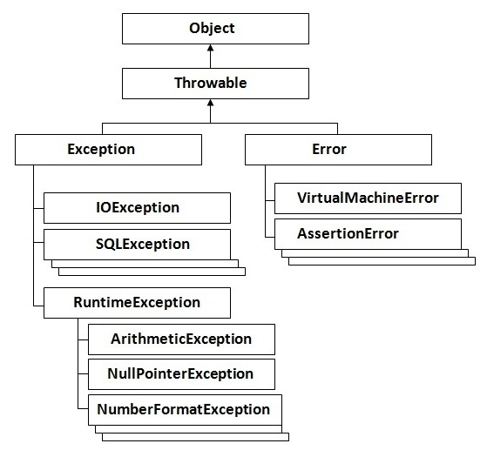
Hierarchy of Java Exception classes

Slide 8
Types of Exception
Checked Exception
Unchecked Exception
The classes that extend Exception class except RuntimeException are known as checked exceptions e.g.IOException, SQLException etc. Checked exceptions are checked at compile-time.
The classes that extend RuntimeException are known as unchecked exceptions e.g. ArithmeticException, NullPointerException, ArrayIndexOutOfBoundsException etc. Unchecked exceptions are not checked at compile-time rather they are checked at runtime.

Slide 9
Error?
Error is irrecoverable
e.g. OutOfMemoryError,
VirtualMachineError,
AssertionError etc.

Slide 10
Common scenarios where exceptions may occur

Slide 11
1) Scenario where ArithmeticException occurs
If we divide any number by zero, there occurs an ArithmeticException.
int a=50/0;//ArithmeticException

Slide 12
2) Scenario where NullPointerException occurs
If we have null value in any variable, performing any operation by the variable occurs an NullPointerException.
String s=null;
System.out.println(s.length());//NullPointerException

Slide 13
Guess the output
public class Test {
public static void main(String[] args) {
String a = null;
a+="Hello";
System.out.println(a);
}
}

Slide 14
Output
nullHello

Slide 15
3) Scenario where NumberFormatException occurs
The wrong formatting of any value, may occur NumberFormatException. Suppose I have a string variable that have characters, converting this variable into digit will occur NumberFormatException.
String s="abc";
int i=Integer.parseInt(s);//NumberFormatException

Slide 16
Example:
import java.util.Scanner;
public class NumberFormatExceptionEx {
public static void main(String[] args) {
Scanner scanner = new Scanner(System.in);
System.out.println("Enter your age");
int inputAge = scanner.nextInt();
try {
if(inputAge<18){
System.out.println("not eligible for vote");
}else{
System.out.println("eligible");
}
} catch (NumberFormatException e) {
System.err.println("Please enter only numbers");
}}}

Slide 17
4) Scenario where ArrayIndexOutOfBoundsException occurs
int a[]=new int[5];
a[10]=50; //ArrayIndexOutOfBoundsException

Slide 18
Scenario 5: InvocationTargeException
The InvocationTargetException is a checked exception that wraps an exception thrown by an invoked method or constructor. The thrown exception is provided at construction time and can be accessed via the getTargetException method. That exception is known as the cause and can be accessed via the getCause method.
To figure out what the problem is with your method itself, wrap the invoke method call around a try-catch block and log invocationTargetException.getTargetException().

Slide 19
Constructors summary
protected | InvocationTargetException()Constructs an InvocationTargetException with null as the target exception.
 | InvocationTargetException(Throwable target)Constructs a InvocationTargetException with a target exception.
 | InvocationTargetException(Throwable target, String s)Constructs a InvocationTargetException with a target exception and a detail message.

Slide 20
Methods Summary
Throwable | getCause()Returns the cause of this exception (the thrown target exception, which may be null). Overrides: getCause in class Throwable
Throwable | getTargetException()Get the thrown target exception.

Slide 21
public class Test {
int m1(String name) {
if (null == name || name.length() == 0) {
throw new RuntimeException();
}
return name.length();
}
public static void main(String[] args) throws Exception {
try {
Class c = Class.forName("Test");
Object o = c.newInstance();
Method[] dm = c.getDeclaredMethods();
for (Method method : dm) {
if (method.getName().contains("main")) {
continue;
}
Object invoke = method.invoke(o, "");
System.out.format("%d", invoke);
}
} catch (InvocationTargetException e) {
// Throwable cause = e.getCause();
// Throwable targetException = e.getTargetException();
e.printStackTrace();
}}}

Slide 22
Output
java.lang.reflect.InvocationTargetException
at sun.reflect.NativeMethodAccessorImpl.invoke0(Native Method)
at sun.reflect.NativeMethodAccessorImpl.invoke(NativeMethodAccessorImpl.java:60)
at sun.reflect.DelegatingMethodAccessorImpl.invoke(DelegatingMethodAccessorImpl.java:37)
at java.lang.reflect.Method.invoke(Method.java:611)
at Test.main(Test.java:20)
Caused by: java.lang.RuntimeException
at Test.m1(Test.java:7)
... 5 more

Slide 23
Note
If getCause() returns null value. That means default InvocationTargetException() is invoked.

Slide 24
How to deal with the exception
First of all, coding an application using reflection is hard. A developer must have a strong grasp of the internal structure of the Java programming language, because the usage of reflection contains drawbacks and dangers, such as performance overhead and exposure of internal fields and methods.
If you decide to use reflection, consider enclosing your code inside a try-catch statement and manipulate the InvocationTargetException accordingly. Notice that the result of the getCause method can be one of the following:
A null value.
An unchecked exception, such as RuntimeException, IllegalArgumentException, NullPointerException, etc.
A checked exception, such as NameNotFoundException, etc.
A java.lang.Error, such as StackOverflowError, OutOfMemoryError, etc.
In your application’s code, make sure that you check for all aforementioned cases, otherwise your code may produce undesired bugs.

Slide 25
Scenario 6: NoSuchMethodException
NoSuchMethodException occurs when you're using reflection and try to dynamically use a method on a class, and the method does not actually exist.
Simply definition: Thrown when a particular method cannot be found.

Slide 26
Constructors
NoSuchMethodException()Constructs a NoSuchMethodException without a detail message.
NoSuchMethodException(String s)Constructs a NoSuchMethodException with a detail message.

Slide 27
public class Test {
int m1(String name) {
if (null == name || name.length() == 0) {
throw new RuntimeException();
}
return name.length();
}
public static void main(String[] args) throws Exception {
try {
Class c = Class.forName("Test");
//Trying to call m2 method, But the method is not available
Method declaredMethod = c.getDeclaredMethod("m2", null);
} catch (NoSuchMethodException e) {
e.printStackTrace();
}
}
}

Slide 28
Output
java.lang.NoSuchMethodException: Test.m2()
at java.lang.Class.throwNoSuchMethodException(Class.java:284)
at java.lang.Class.getDeclaredMethod(Class.java:601)
at Test.main(Test.java:16)

Slide 29
Java Exception Handling Keywords
try
catch
finally
throw
throws

Slide 30
try-catch block

Slide 31
try block
Java try block is used to enclose the code that might throw an exception. It must be used within the method.
Java try block must be followed by either catch or finally block.

Slide 32
Syntax of java try-catch
try{
//code that may throw exception
}catch(Exception_class_Name ref){}

Slide 33
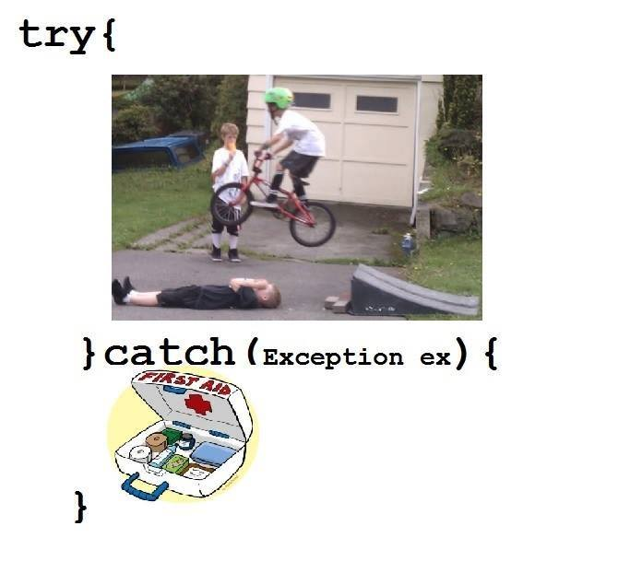

Slide 34
Syntax of try-finally block
try{
//code that may throw exception
}finally{}

Slide 35
Java catch block
Java catch block is used to handle the Exception. It must be used after the try block only.
You can use multiple catch block with a single try.

Slide 36
Problem without exception handling
public class Testtrycatch1{
public static void main(String args[]){
int data=50/0;//may throw exception
System.out.println("rest of the code...");
}
}

Slide 37
output
Exception in thread main java.lang.ArithmeticException:/ by zero

Slide 38
Solution by exception handling
public class Testtrycatch2{
public static void main(String args[]){
try{
int data=50/0;
}catch(ArithmeticException e){System.out.println(e);}
System.out.println("rest of the code...");
}
}

Slide 39
output
Exception in thread main java.lang.ArithmeticException:/ by zero
rest of the code...

Slide 40
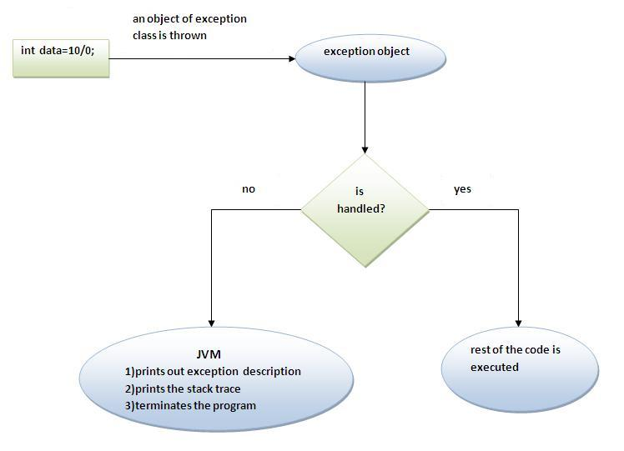
Internal working of java try-catch block

Slide 41
Guess the output
double res = 12.0/0;
System.out.println(res);
Output: ??
double res = 12/0.0;
System.out.println(res);
Output: ??
double res = 12/0;
System.out.println(res);
Output:??

Slide 42
Multi catch block
If you have to perform different tasks at the occurrence of different Exceptions, use java multi catch block.

Slide 43
Example
public class TestMultipleCatchBlock{
public static void main(String args[]){
try{
int a[]=new int[5];
a[5]=30/0;
}
catch(ArithmeticException e){System.out.println("task1 is completed");}
catch(ArrayIndexOutOfBoundsException e){System.out.println("task 2 completed");}
catch(Exception e){System.out.println("common task completed");}
System.out.println("rest of the code...");
}
}

Slide 44
Notes
At a time only one Exception is occured and at a time only one catch block is executed.
All catch blocks must be ordered from most specific to most general i.e. catch for ArithmeticException must come before catch for Exception .

Slide 45
Guess output
class TestMultipleCatchBlock1{
public static void main(String args[]){
try{
int a[]=new int[5];
a[5]=30/0;
}
catch(Exception e){System.out.println("common task completed");}
catch(ArithmeticException e){System.out.println("task1 is completed");}
catch(ArrayIndexOutOfBoundsException e){System.out.println("task 2 completed");}
System.out.println("rest of the code...");
}
}

Slide 46
Output
Compile time error

Slide 47
Nested try block
The try block within a try block is known as nested try block in java.

Slide 48
Why use nested try block
Sometimes a situation may arise where a part of a block may cause one error and the entire block itself may cause another error. In such cases, exception handlers have to be nested.

Slide 49
Syntax:
....
try
{
statement 1;
statement 2;
try
{
statement 1;
statement 2;
}
catch(Exception e)
{
}
}
catch(Exception e)
{
}
....

Slide 50
Java nested try example
class Excep{
public static void main(String args[]){
try{
try{
System.out.println("going to divide");
int b =39/0;
}catch(ArithmeticException e){System.out.println(e);}
try{
int a[]=new int[5];
a[5]=4;
}catch(ArrayIndexOutOfBoundsException e){System.out.println(e);}
System.out.println("other statement);
}catch(Exception e){System.out.println("handeled");}
System.out.println("normal flow..");
}
}

Slide 51
finally block

Slide 52
finally block
Java finally block is a block that is used to execute important code such as closing connection, stream etc.
Java finally block is always executed whether exception is handled or not.
Java finally block must be followed by try or catch block.

Slide 53
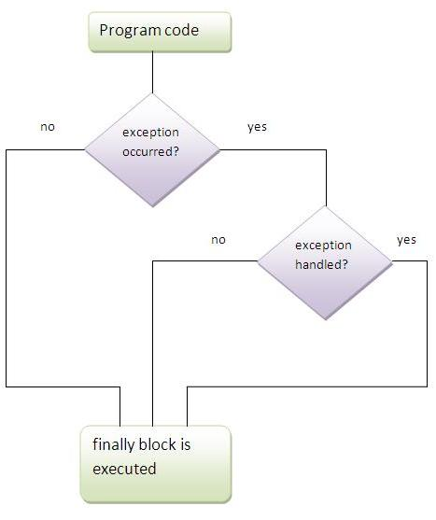
finally block

Slide 54
Note
If you don't handle exception, before terminating the program, JVM executes finally block(if any).

Slide 55
Why use java finally
Finally block in java can be used to put "cleanup" code such as closing a file, closing connection etc.

Slide 56
Usage of Java finally Case 1 : When exception doesn’t occur
class TestFinallyBlock{
public static void main(String args[]){
try{
int data=25/5;
System.out.println(data);
}
catch(NullPointerException e){System.out.println(e);}
finally{System.out.println("finally block is always executed");}
System.out.println("rest of the code...");
}
}

Slide 57
Usage of Java finally Case 2 : When exception occurs and not handled
class TestFinallyBlock1{
public static void main(String args[]){
try{
int data=25/0;
System.out.println(data);
}
catch(NullPointerException e){System.out.println(e);}
finally{System.out.println("finally block is always executed");}
System.out.println("rest of the code...");
}
}

Slide 58
Usage of Java finally Case 3: When exception occurs and handled
public class TestFinallyBlock2{
public static void main(String args[]){
try{
int data=25/0;
System.out.println(data);
}
catch(ArithmeticException e){System.out.println(e);}
finally{System.out.println("finally block is always executed");}
System.out.println("rest of the code...");
}
}

Slide 59
Notes
For each try block there can be zero or more catch blocks, but only one finally block.
The finally block will not be executed if program exits(either by calling System.exit() or by causing a fatal error that causes the process to abort).

Slide 60
***Guess the output
public class TryFinally {
public static void main(String[] args) {
try {
System.out.println("try block");
System.exit(0);
} finally {
System.out.println("Finally block");
}
}
}

Slide 61
Output
finally

Slide 62
*****Guess the outuput?
public class Test{
public void m1(){
int x = 0;
try {
x = 1/0;
} catch (NullPointerException ne) {
System.out.println("null ex");
}finally{
System.out.println("In finally block");
return;
}
}
public static void main(String[] args) {
Test t = new Test();
t.m1();
System.out.println("successfully executed");
}
}

Slide 63
output
In finally block
successfully executed

Slide 64
throw keyword

Slide 65
throw keyword
The Java throw keyword is used to explicitly throw an exception.
We can throw either checked or uncheked exception in java by throw keyword. The throw keyword is mainly used to throw custom exception. We will see custom exceptions later.
Syntax:
throw exception;
Ex: throw new IOException("sorry device error);

Slide 66
throw keyword example
In this example, Create validate method that takes integer value as a parameter. If the age is less than 18, throw the ArithmeticException otherwise print a message welcome to vote

Slide 67
throw keyword example
public class TestThrow1{
static void validate(int age){
if(age<18)
throw new ArithmeticException("not valid");
else
System.out.println("welcome to vote");
}
public static void main(String args[]){
validate(13);
System.out.println("rest of the code...");
}
}

Slide 68
Exception handling in Javascript
Most of you already known that exception handling in javascript is almost same as in java. Below two examples help you to understand it quickly.

Slide 69
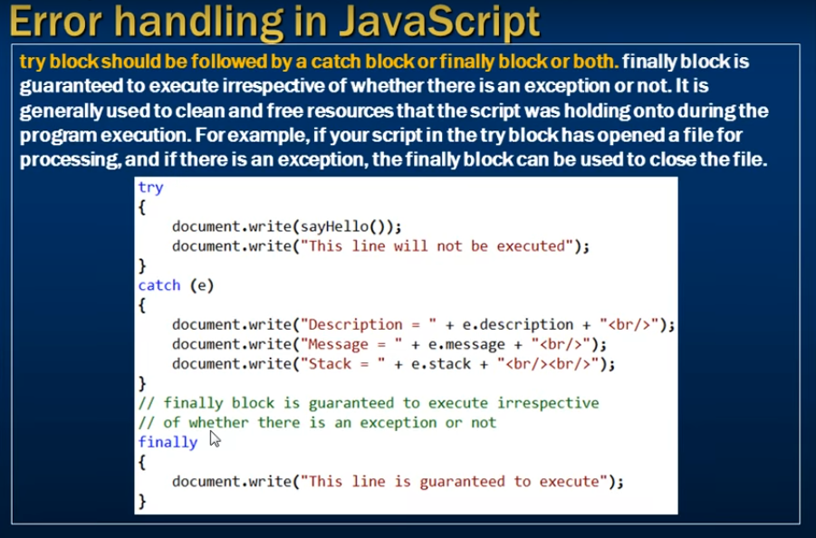
Example 1: sayHello() function is not defined, Hence java script error will occur.

Slide 70
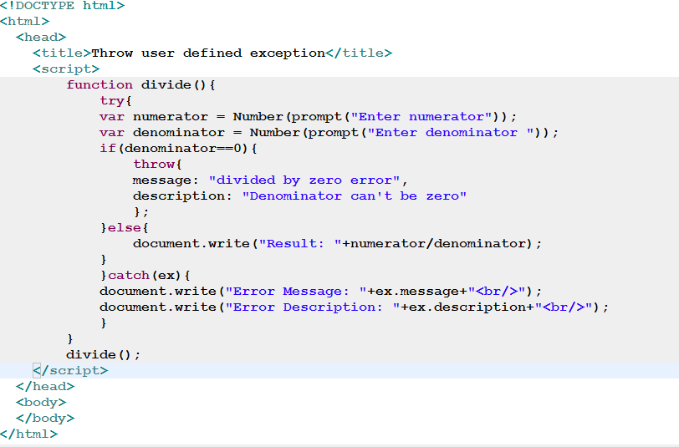
Example 2: throw user defined exception when denominator value is entered as 0.

Slide 71
Exception Propagation

Slide 72
Exception propagation
An exception is first thrown from the top of the stack and if it is not caught, it drops down the call stack to the previous method, If not caught there, the exception again drops down to the previous method, and so on until they are caught or until they reach the very bottom of the call stack.This is called exception propagation.

Slide 73
Program of Exception Propagation
class TestExceptionPropagation1{
void n(){
int data=50/0;
}
void m(){
try{
n();
}catch(Exception e){System.out.println("exception handled");}
}
public static void main(String args[]){
TestExceptionPropagation1 obj=new TestExceptionPropagation1();
obj.m();
System.out.println("normal flow...");
}
}

Slide 74
Output
Exception handled
Normal flow

Slide 75
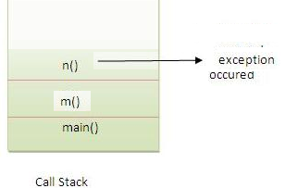
Exception Propagation stack representation

Slide 76
Note
In the above example exception occurs in n() method where it is not handled,so it is propagated to previous m() method where it is handled.
Exception can be handled in any method in call stack either in main() method,m() method or n() method

Slide 77
throws Keyword
The Java throws keyword is used to declare an exception. It gives an information to the programmer that there may occur an exception so it is better for the programmer to provide the exception handling code so that normal flow can be maintained.
Exception Handling is mainly used to handle the checked exceptions. If there occurs any unchecked exception such as NullPointerException, it is programmers fault that he is not performing check up before the code being used.

Slide 78
Syntax of java throws
return_type method_name() throws exception_class_name{
//method code
}

Slide 79
Which exception should be declared
checked exception only, because:
unchecked Exception: under your control so correct your code.
error: beyond your control e.g. you are unable to do anything if there occurs VirtualMachineError or StackOverflowError.

Slide 80
Advantage of Java throws keyword
It provides information to the caller of the method about the exception.

Slide 81
Java throws example
class Testthrows1{
void m()throws IOException{
throw new IOException("device error");//checked exception
}
public static void main(String args[]) throws IOException{
Testthrows1 obj=new Testthrows1();
obj.m();
System.out.println("normal flow...");
}
}

Slide 82
output
Exception handled
Normal flow…

Slide 83
Notes
If you are calling a method that declares an exception, you must either catch or declare the exception.
Two cases:
Case1:You catch the exception i.e. handle the exception using try/catch.
Case2:You declare the exception i.e. specifying throws with the method.

Slide 84
Case1: handle the exception
public class TestThrows {
static void m1() throws IOException{
throw new IOException();
}
public static void main(String[] args) {
try {
m1();
} catch (IOException e) {
// TODO Auto-generated catch block
e.printStackTrace();
}
}
}

Slide 85
output
Exception handled
Normal flow…

Slide 86
Case2: declare the exception
public class TestThrows {
static void m1() throws IOException{
throw new IOException();
}
public static void main(String[] args) throws IOException {
m1();
}
}

Slide 87
Output
Runtime error

Slide 88
Que) Can we re throw an exception?
Yes, by throwing same exception in catch block. public class TestThrows {
static void m1() throws IOException{
throw new IOException();
}
public static void main(String[] args) throws IOException {
try {
m1();
} catch (IOException e) {
throw e; //re throw an exception
}
}
}

Slide 89
Difference between throw and throws in Java
No. | throw | throws
1) | Java throw keyword is used to explicitly throw an exception. | Java throws keyword is used to declare an exception.
3) | Throw is followed by an instance. Ex: throw new ArithmeticException(); | Throws is followed by class. Ex: throws Exception
4) | Throw is used within the method. | Throws is used with the method signature.
5) | You cannot throw multiple exceptions. | You can declare multiple exceptions e.g. public void method()throws IOException,SQLException.

Slide 90
Difference between throw and throws
Java throw example
void m(){
throw new ArithmeticException("sorry");
}
Java throws example
void m()throws ArithmeticException{
//method code
}

Slide 91
Java throw and throws example
void m()throws ArithmeticException{
throw new ArithmeticException("sorry");
}

Slide 92
What are differences among throw, throws and thrown?
Thrown is invalid

Slide 93
Difference between final, finally and finalize
No. | final | finally | finalize
1) | Final is used to apply restrictions on class, method and variable. Final class can't be inherited, final method can't be overridden and final variable value can't be changed. | Finally is used to place important code, it will be executed whether exception is handled or not. | Finalize is used to perform clean up processing just before object is garbage collected.
2) | final is a keyword. | finally is a block. | finalize is a method.

Slide 94
final example
class FinalExample{
public static void main(String[] args){
final int x=100;
x=200;//Compile Time Error
}}

Slide 95
finally example
class FinallyExample{
public static void main(String[] args){
try{
int x=300;
}catch(Exception e){System.out.println(e);}
finally{System.out.println("finally block is executed");}
}}

Slide 96
finalize example
class FinalizeExample{
public void finalize(){System.out.println("finalize called");}
public static void main(String[] args){
FinalizeExample f1=new FinalizeExample();
FinalizeExample f2=new FinalizeExample();
f1=null;
f2=null;
System.gc();
}}

Slide 97
ExceptionHandling with MethodOverriding in Java

Slide 98
ExceptionHandling with MethodOverriding
There are many rules if we talk about methodoverriding with exception handling. The Rules are as follows: If the superclass method does not declare an exception
If the superclass method does not declare an exception, subclass overridden method cannot declare the checked exception but it can declare unchecked exception.
If the superclass method declares an exception
If the superclass method declares an exception, subclass overridden method can declare same, subclass exception or no exception but cannot declare parent exception.

Slide 99
Case 1: If the superclass method does not declare an exception

Slide 100
1) Rule: If the superclass method does not declare an exception, subclass overridden method cannot declare the checked exception.
class Parent{
void msg(){System.out.println("parent");}
}
class TestExceptionChild extends Parent{
void msg()throws IOException{
System.out.println("TestExceptionChild");
}
public static void main(String args[]){
Parent p=new TestExceptionChild();
p.msg();
}
}

Slide 101
Output
Compile time error

Slide 102
2) Rule: If the superclass method does not declare an exception, subclass overridden method cannot declare the checked exception but can declare unchecked exception
class Parent{
void msg(){System.out.println("parent");}
}
class TestExceptionChild1 extends Parent{
void msg()throws ArithmeticException{
System.out.println("child");
}
public static void main(String args[]){
Parent p=new TestExceptionChild1();
p.msg();
}
}

Slide 103
Output
Child

Slide 104
If the superclass method declares an exception

Slide 105
1) Rule: If the superclass method declares an exception, subclass overridden method can declare same, subclass exception or no exception but cannot declare parent exception.
class Parent{
void msg()throws ArithmeticException{System.out.println("parent");}
}
class TestExceptionChild2 extends Parent{
void msg()throws Exception{System.out.println("child");}
public static void main(String args[]){
Parent p=new TestExceptionChild2();
try{
p.msg();
}catch(Exception e){}
}
}

Slide 106
Output
Compile time error

Slide 107
Example in case subclass overridden method declares same exception
class Parent{
void msg()throws Exception{System.out.println("parent");}
}
class TestExceptionChild3 extends Parent{
void msg()throws Exception{System.out.println("child");}
public static void main(String args[]){
Parent p=new TestExceptionChild3();
try{
p.msg();
}catch(Exception e){}
}
}

Slide 108
Output
Child

Slide 109
Example in case subclass overridden method declares subclass exception
class Parent{
void msg()throws Exception{System.out.println("parent");}
}
class TestExceptionChild4 extends Parent{
void msg()throws ArithmeticException{System.out.println("child");}
public static void main(String args[]){
Parent p=new TestExceptionChild4();
try{
p.msg();
}catch(Exception e){}
}
}

Slide 110
Output
child

Slide 111
Example in case subclass overridden method declares no exception
class Parent{
void msg()throws Exception{System.out.println("parent");}
}
class TestExceptionChild5 extends Parent{
void msg(){System.out.println("child");}
public static void main(String args[]){
Parent p=new TestExceptionChild5();
try{
p.msg();
}catch(Exception e){}
}
}

Slide 112
output
Child

Slide 113
Custom/User defined Exception

Slide 114
Custom Exception
If you are creating your own Exception that is known as custom exception or user-defined exception. Java custom exceptions are used to customize the exception according to user need.
By the help of custom exception, you can have your own exception and message.

Slide 115
InvalidAgeException Class
class InvalidAgeException extends Exception{
InvalidAgeException(String s){
super(s);
}
}

Slide 116
TestCustomException1
class TestCustomException1{
static void validate(int age)throws InvalidAgeException{
if(age<18)
throw new InvalidAgeException("not valid");
else
System.out.println("welcome to vote");
}
public static void main(String args[]){
try{
validate(13);
}catch(Exception m){System.out.println("Exception occured: "+m);}
System.out.println("rest of the code...");
}
}

Slide 117
Output
Exception occurred: InvalidAgeException: not valid

Slide 118
***Diff b/w ClassNotFoundException and NoClassDefFoundError
Both exceptions are occurred when particular class in not available at runtime at different scenarios
ClassNotFoundException is an exception that occurs when you try to load a class at run time using Class.forName() or loadClass() methods and mentioned classes are not found in the classpath. – Checked Exception
NoClassDefFoundError is an error that occurs when a particular class is present at compile time, but was missing at run time
It’s error category extends Error

Slide 119
ClassNotFoundException
For example, load A class which is not found in the classpath.
public class Test {
public static void main(String[] args) throws ClassNotFoundException {
Class.forName("A");
}
}

Slide 120
NoClassDefFoundError
class A {
} //Delete A.class from classes folder
public class Test {
public static void main(String[] args {
A a = new A();
}
}

Slide 121
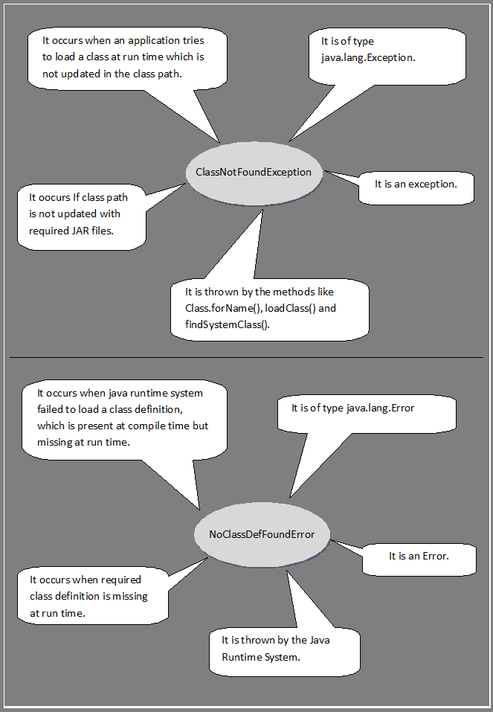

Slide 122
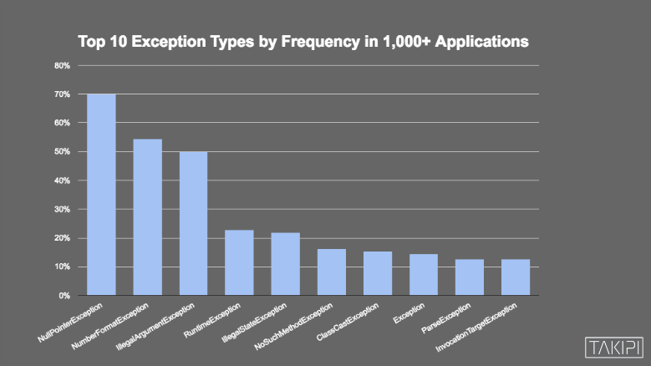
The Top 10 Exception Types in Production Java Applications

Slide 123
1. NullPointerException – 70% of Production Environments
It’s thrown when you try to perform some action on null reference.
2. NumberFormatException – 55% of Production Environments
It’s thrown when you try to convert a string to a numeric value and the String is not formatted correctly.
3. IllegalArgumentException – 50% of Production Environments
It’s thrown when you’re passing arguments from an unexpected type to your methods. For example, some method that expects type X and you’re calling it with type Y as an argument
4. RuntimeException – 23% of Production Environments
Actually Java language doesn’t throw RuntimeException directly.
There are 2 main use cases to explicitly throw a RuntimeException from your code:
Throwing a new “generic” unchecked exception
Rethrows:
“Wrapping” a general unchecked exception around another exception that extends RuntimeException
Making a checked exception unchecked

Slide 124
5. IllegalStateException – 22% of Production Environments
when you’re trying to use a method in an illegal or inappropriate time, like if you use URLConnection, trying to do something assuming you’re not connected, and get “IllegalStateException: Already Connected”.
6. NoSuchMethodException – 16% of Production Environments
It’s thrown when you’re trying to use a method that doesn’t exist, which happens when you’re using reflection and getting the method name from some variable (dynamically)
7. ClassCastException – 15% of Production Environments
It’s thrown when we’re trying to cast a class to another class of which it is not an instance.
8. Exception – 15% of Production Environments
Exception is mother of all exceptions. (Grandmother is Throwable). Java never throws plain Exceptions directly. You need a checked exception to be thrown for some reason from your code.
9. ParseException – 13% of Production Environments
It’s thrown whenever we’re passing a string to parse into something else, and it’s not formatted the way it’s supposed to
10. InvocationTargetException – 13% of Production Environments
When something goes wrong in an invoked method, that exception is then wrapped with an InvocationTargetException.

